Slide 1
SPARSE MATRICES

Slide 2
What are SPARSE MATRICES?
υ
A sparse matrix is a matrix having a relatively small number of nonzero elements.
υ
Consider the following as an example of a sparse matrix A:

Slide 3
Importance of Sparse Matrices
Sparse matrices are used by scientists and engineers when solving partial differential equations. For example, a measurement of a matrix's sparsity can be useful when developing theories about the connectivity of computer networks. When using large sparse matrices in a computer program, it is important to optimize the data structures and algorithms to take advantage of the fact that most of the values will be zero.

Slide 4
Sparse vs. Dense Matrices

Slide 5
Example Of Structured Sparse Matrices
diagonal
tridiagonal
triangular

Slide 6
Structured Sparse Matrices:
Triangular Matrices:
Triangular matrices have the same number of rows as they have columns; that is, they have n rows and n columns. In triangular matrix both main and lower diagonals are filled with non-zero values or main diagonal and upper storing diagonals are filled with non-zero values.
Band Matrices:
A band matrix is a sparse matrix whose non-zero entries are confined to a diagonal band, comprising the main diagonal and zero or more diagonals on either side.

Slide 7
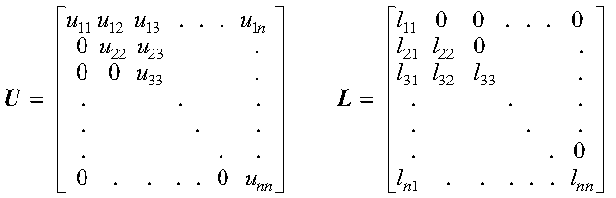
Types of Triangular Matrices:
Upper triangular matrix:
Lower triangular matrix:
A matrix A is a lower triangular matrix if its nonzero elements are found only in the lower triangle of the matrix, including the main diagonal;
If(i>j)
return a_{ij}=a[i*(i+1)/2+j]
else return 0
υ
A matrix A is an upper triangular matrix if its nonzero elements are found only in the upper triangle of the matrix, including the main diagonal;
If(i<j)
return a_{ij}=a[i*n−(i−1)i/2+j]
else return 0
υ

Slide 8
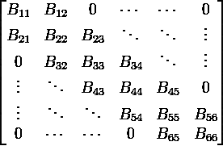
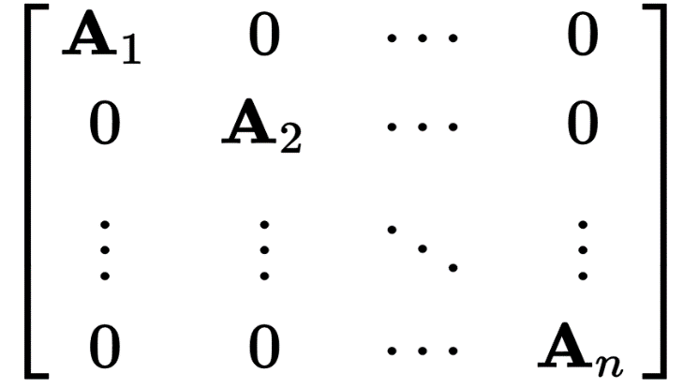
Types of Band Matrices:
Diagonal matrix
Tri-diagonal matrix
A tri-diagonal matrix is a matrix that has nonzero elements only in the
main diagonal, the first diagonal below this, and the first diagonal above the main diagonal.
υ
Let A be a square matrix (with entries in any field). If all off- diagonal entries of A are non- zero, then A is a diagonal matrix.
arr_d[i]=x if i=j;
υ

Slide 9
Unstructured Sparse Matrices
Airline flight matrix.
airports are numbered 1 through n
flight(i,j) = list of nonstop flights from airport i to airport j
♣ n = 1000 (say)
n x n array of list references => 4 million bytes
total number of flights = 20,000 (say)
need at most 20,000 list references => at most 80,000 bytes

Slide 10
Unstructured Sparse Matrices
Web page matrix.
web pages are numbered 1 through n
web(i,j) = number of links from page i to page j
Web analysis.
authority page … page that has many links to it hub page … links to many authority pages

Slide 11
Web Page Matrix
n = 2 billion (and growing by 1 million a day)
n x n array of ints => 16 * 10¹⁸ bytes (16 * 10⁹ GB)
each page links to 10 (say) other pages on average
on average there are 10 nonzero entries per row
space needed for nonzero elements is approximately 20 billion x 4 bytes = 80 billion
bytes (80 GB)

Slide 12
Data Structures for Matrices Approximate Memory Requirements
500 x 500 matrix with 1994 nonzero elements
Full: 2D array 500 x 500 x 4 = 1million bytes
Only Non-Zeros:Single Array List 3 x 1994 x 4 = 23,928 bytes

Slide 13
Representation of Sparse Matrices
Formats can be divided into two groups:
Those that support efficient modification, such as DOK (Dictionary of keys), LIL (List of lists), or COO (Coordinate list). These are typically used to construct the matrices.
Those that support efficient access and matrix operations, such as CSR (Compressed Sparse Row) or CSC (Compressed Sparse Column).

Slide 14
Representation Of Unstructured Sparse Matrices
Coordinate list (COO)
COO stores a list of (row, column, value) tuples. Ideally, the entries are sorted (by row index, then column index) to improve random access times.
0 0 3 0 4
0 0 5 7 0
0 0 0 0 0
0 2 6 0 0

Slide 15
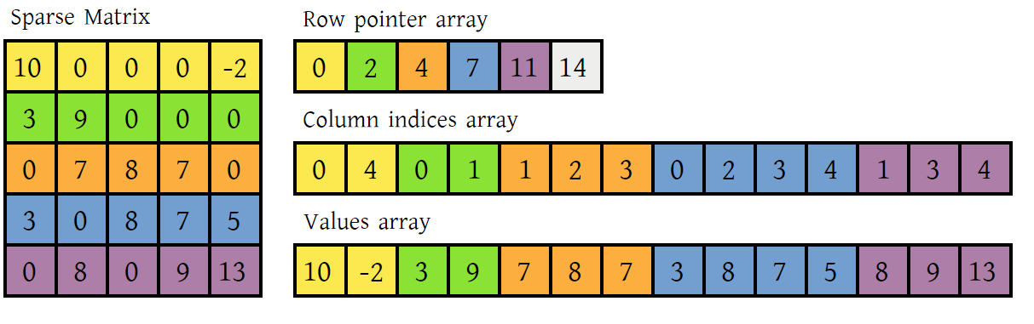
Representation Of Unstructured Sparse Matrices
Compressed Sparse ROW(CSR)
The compressed sparse row (CSR) format represents a matrix M by three (one-dimensional) arrays, that respectively contain nonzero values, the extents of rows, and column indices. It is similar to COO, but compresses the row indices, hence the name.

Slide 16
Representation Of Unstructured Sparse Matrices
Compressed Sparse Column (CSR)
The CSR format stores a sparse m × n matrix M in column form using three (one-dimensional) arrays (A, IR, JC). Let NNZ denote the number of nonzero entries in M.
2
3

Slide 17
Practice From Book on Sparse Matrices Topic
4.13 and 4.14
Reference :
Schaum’s Outlines Data Structures By
Seymoru Lipschutz

